Slide 1

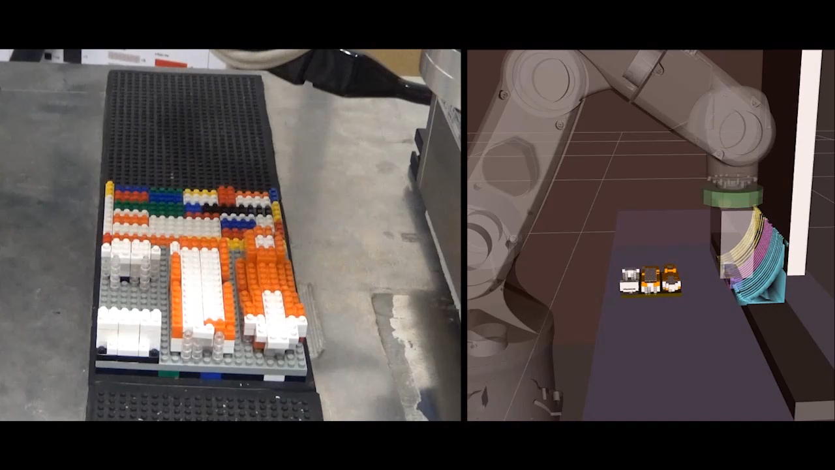
A Force-based Assemblability Analysis for a Robotic 3D Block Printer
* Saman Diogenes N Cesarino Pedro
Yokohama National University
Yusuke Maeda
Yokohama National University
Notes:
Applications:
Building complex lego-like structures to be displayed in public events.
It is possible to utilize it together with typical 3D printers to create flexible prototype design
The main advantage is being able to use multiple different materials during assemble without having to stop
And, the possibility to print with multiple colors at the same time
The possibility to disassemble and reuse the parts after the object is not more needed.

Slide 2
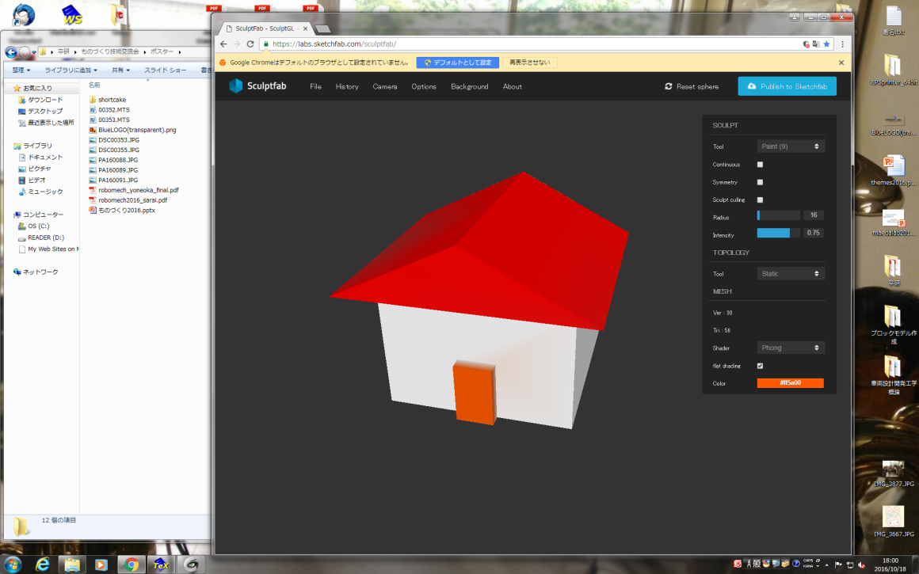
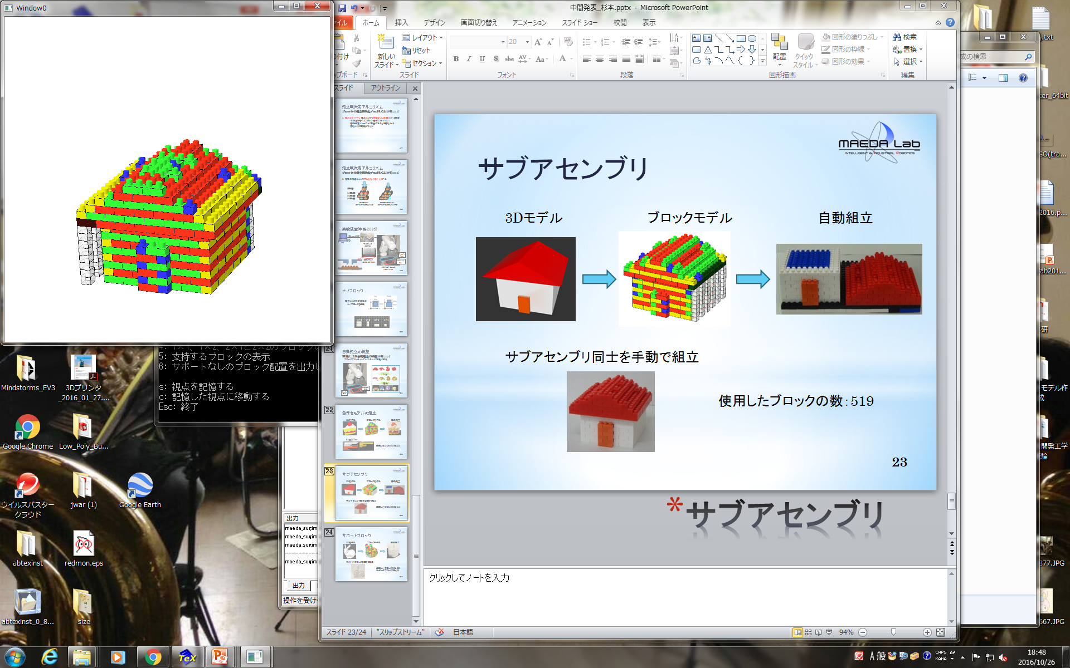
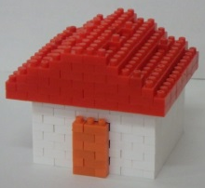
overview
The Robotic 3D block printer performs additive manufacturing. [Kohama+ 2021].
A 3D CAD object is used as input and converted to block model using the “Nanoblock” size parameters.
Assembly planning verifies if the operation is safe and make changes if necessary.
A physics-based stability metric is desired to guide the assembly planning.
If it is safe, the robot movement is generated to automatically assemble the object.
Notes:
The 3D block printer is a robotic 3D printer…
A 3D CAD object is used as input
Before sending to the robot, it is created an assembly plan to ensure a safe operation
It is desired a physics-based…
If safe, robot movement is generated…

Slide 3
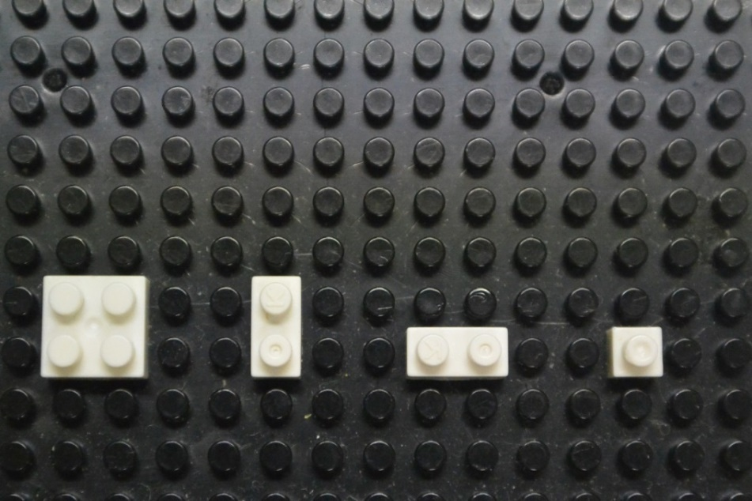

Previous Assembly Planning
The assembly planning is responsible to verify if the insertion of every brick in the block model is safe.
Before, it had an empirical approach to estimate stability [Kohama+ 2021].
Was able to utilize only 3 small block types.
Was not too reliable, as the judge did not use physics laws to test stability.
2×2 2×1 1×1
Notes:
Main concern: know if the insertion force not break.
The figure is an example of empirical analysis….
Because of the nature of the empirical strategy only small blocks…
Not reliable because not based in physics but empirical thoughts…

Slide 4
Stabilizing Strategies (1/2)
There are some options if the judge decides the block insertion is not safe.
A simply change in order can turn a non-assemblable structure into an assembable one.
Place A before B
Place B before A
A
B
A
B
Notes:
If the judge decides that it is not stable...
A simple change in order …

Slide 5
Stabilizing Strategies (2/2)
Sometimes no order can make a structure assembable
One possible solution is to use transparent blocks as support pillars.
Other option is to divide the structure and create sub-assemblies.
Notes:
But there are cases…
Support pillars… Downside: remove the support after
Subasseblies… Downside: must manually put together the subassemblies

Slide 6
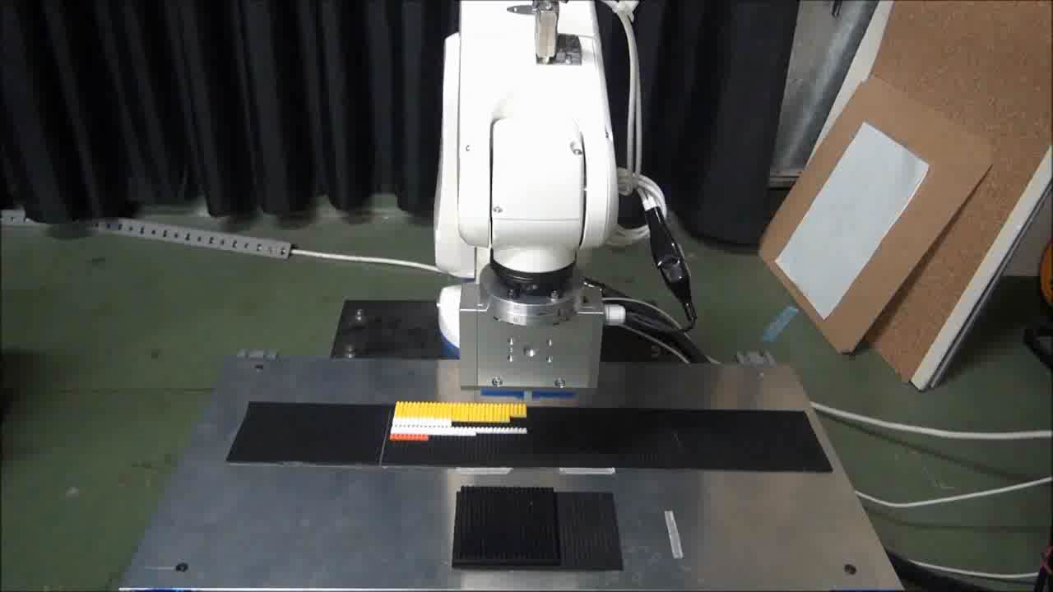
Objective
Substitute the assembly planning empirical approach to a force-based one.
Measure the experimental values needed.
Increase the number of usable block types.
Adapt the three stabilizing strategies to the new assembly planner architecture.
Incorporate the new planner to the ROS side to apply it with robots.
Notes:
The objective of this present work is to substitute the old…
It is necessary to measure the experimental values: each block type mass and maximum friction force
It is also of interest to increase the block types
Also, to adapt the three stabilizing strategies
Finally, incorporate …

Slide 7
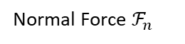
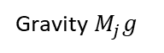
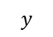
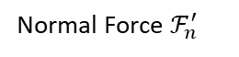
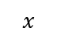
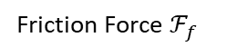
Mechanical analysis (1/3)
Is an algorithm that determines the position of every force that appear in the structure [Maeda+ 2019].
In a structure at rest, there are normal, friction and gravity forces.
A pushing force appears when a block is being inserted by the robot.
Using the static balance of forces and torques it is possible to create a stability metric.
Friction Force $ℱ_{f}$
Normal Force $ℱ_{n}^{′}$
$$y$$
Normal Force $ℱ_{n}$
Gravity $M_{j}g$
$$x$$
Pushing Force
Top view
Front view
Notes:
A first version
Created to judge the stability during assembly
Force-based algorithm that determines position of forces every single block
Explain the forces
With the static balance condition it is possible to create a stability metric.

Slide 8
Mechanical analysis (2/3)
Capacity [Luo+ 2015] is utilized as stability metric for every block connection.
Capacity is calculated as: the difference between the maximum static friction force possible and the resultant force calculated.
In other words: for each connection, it is how much more force can be applied before breaking it.
Knowing the exact value of every forces in such complex system is hard.
A linear programing problem is defined to search for a distribution of forces that maximizes the minimum capacity in the entire structure.
The optimization constrains are the static balance of forces and torques in all three axis.
Notes:
Capacity is a term…
And it is calculated…
In other words…
Knowing the exact value…
So, a linear programing problem was defined to search
If solution is found,
Positive CM is stable …
Negative CM is unstable …
But, we adopted ….

Slide 9
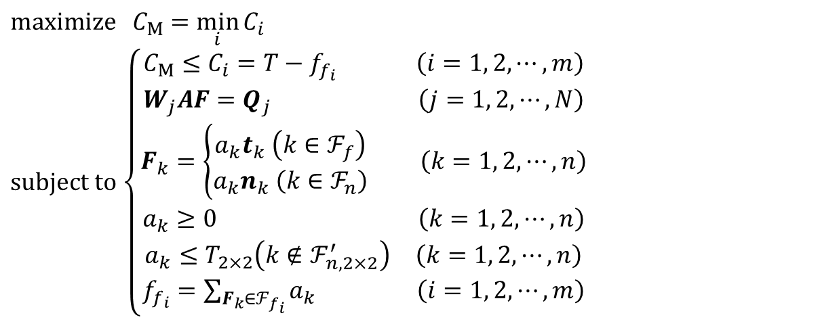
Mechanical analysis (3/3)
$\text{maximize} C_{M}$ $=\min_{i}{C_{i}}$
$\text{subject} \text{to}$ $\left\{\begin{aligned}\begin{matrix}C_{M}≤C_{i}=T−f_{f_{i}} \left(i=1, 2, ⋯,m\right) \\ W_{j}AF=Q_{j} \left(j=1, 2, ⋯,N\right)\end{matrix} \\ F_{k}=\left\{\begin{aligned}a_{k}t_{k} \left(k∈ℱ_{f}\right) \\ a_{k}n_{k} \left(k∈ℱ_{n}\right)\end{aligned}\right. \left(k=1, 2, ⋯,n\right) \\ \begin{matrix}a_{k}≥0 & \left(k=1, 2, ⋯,n\right)\end{matrix} \\ \begin{matrix}a_{k}≤T_{2×2}\left(k∉{\text{ℱ}}_{n,2×2}^{′}\right) & \left(k=1, 2, ⋯,n\right)\end{matrix} \\ f_{f_{i}}=\sum_{F_{k}∈ℱ_{f_{i}}}{a_{k}} \left(i=1, 2, ⋯,m\right)\end{aligned}\right.$
Positive Cm: every block connection can handle the insertion of the new block.
Negative Cm: necessary friction force to guarantee the static condition is greater than the maximum possible.
A conservative approach was adopted.
Notes:
Those are the mathematical equations that defines the optimization algorithm
positive Cm…
Negative Cm…
But, working with such strict binary decision…
Not only Cm has to be positive but by a good margin..

Slide 10
Development
The force-based mechanical analysis was restructured making it possible to use almost all existing Nanoblock block types.
More blocks types = smaller assembly time and bigger variety of input 3D objects.
The assembly planner empirical judge was replaced by the mechanical analysis one increasing the planner trust.
2×2 2×1 1×1
Notes:
About the development of this work
The mechanical analysis was restructured …
Bigger blocks means…
With that update to the mechanical analysis…
Also, the stabilizing strategies…

Slide 11

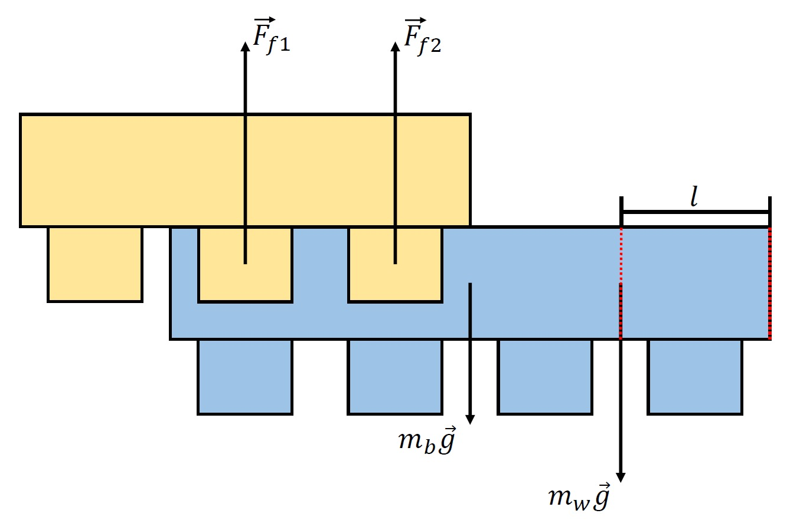
Development (2/2)
New experiments were done to measure the necessary experimental values to be used in the force-based calculation.
Each available block type mass was measured using a precision scale with several different blocks of the same size.
Experiments were done to estimate the maximum friction force a connection can have before disconnecting [Luo+ 2015].
Notes:
As it is now being used physics to analyze stability…
New and more precise experiments…
For the block masses …
Friction forces can not be directly measured…
Setup in the left

Slide 12
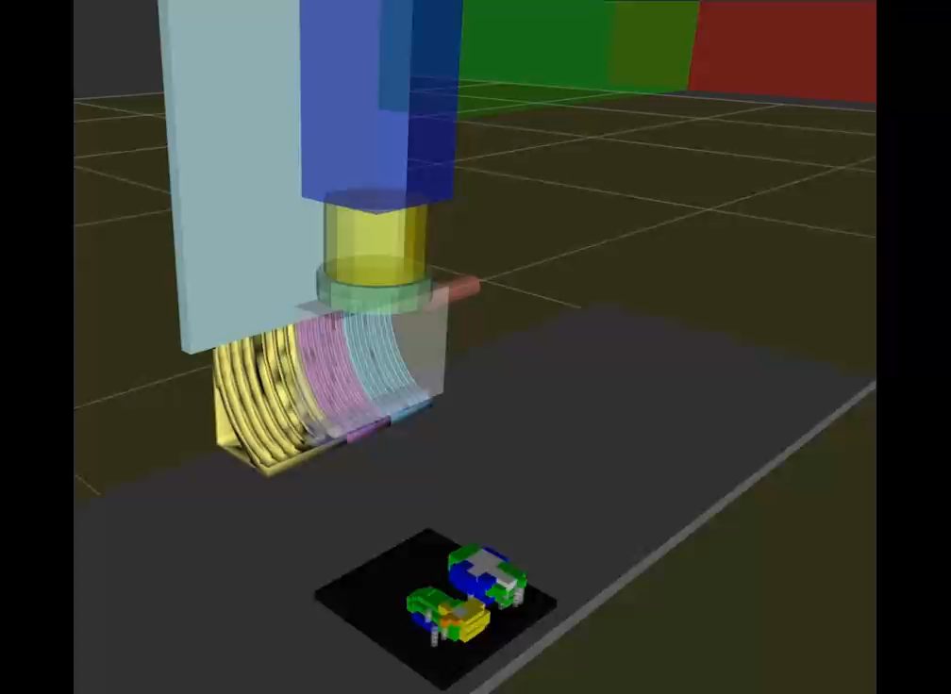
Conclusion
Assembly planner were restructured to replace the empirical judge with the mechanical analysis approach.
Wide range of new block types are now usable.
Experiments were conducted to measure and estimate experimental values.
Reordering and support pillar stabilizing strategies were incorporated to the new planner
Future work
Adapt the subassemblies strategy.
Adapt the ROS side algorithm to work with the new planner.
Utilize the 3D block printer with all the changes.
Notes:
To conclude my presentation…
The 3D block printer assembly planner..
Now a wide range of block types…
Experiments…
For future work…
It is still necessary…
Then, adapt the ROS…
To finally utilize the 3D block printer…

